Slide 1
Generative AI & Prompt Engineering
(SC-589)
No Code AI
Prepared By:
Akshay Patel
Guided By:
Pro. Dr. Chang, Henry

Slide 2
What is the No Code AI?
No-Code AI refers to tools and platforms that allow users to create AI applications without writing code.
Programmers or non-programmers, anyone can do this with the use of Prompt Engineering.

Slide 3
Advantages
Disadvantages
Accessible for non-programmer
Faster Development Time
Lower cost
Empowers domain experts
Limited Customization
Depends on the Platform Provider
Scalability issues
Security Concerns

Slide 4
Approaches
Step 1: Introduction to WebSim.ai
Step 2: Getting Started with WebSim.ai
Step 3: Exploring Example Projects
Step 4: Creating a Portfolio Website
Step 5: Customizing the Website Appearance
Step 6: Saving and Publishing the Website
Step 7: Adding Functional Pages
Step 8: Customizing the Form Fields
Step 9: Adding Action Buttons
Step 10: Sharing and Downloading the Website

Slide 5
Step 1: Introduction to WebSim.ai
Step 2: Getting Started with WebSim.ai
WebSim.ai is an AI tool that allows you to create websites or app prototypes in literally seconds. You don’t need to know how to code or have any technical knowledge. Currently, it costs nothing to use, and you don’t even need to know how to prompt. This tool is going to blow your mind!
To access WebSim.ai, you don’t need to sign up for anything. Simply log in using Google or Discord. As of now, the tool is free, but I highly recommend starting to use it soon as it might not stay free for long. Let’s dive into the capabilities of WebSim.ai by creating something amazing.

Slide 6
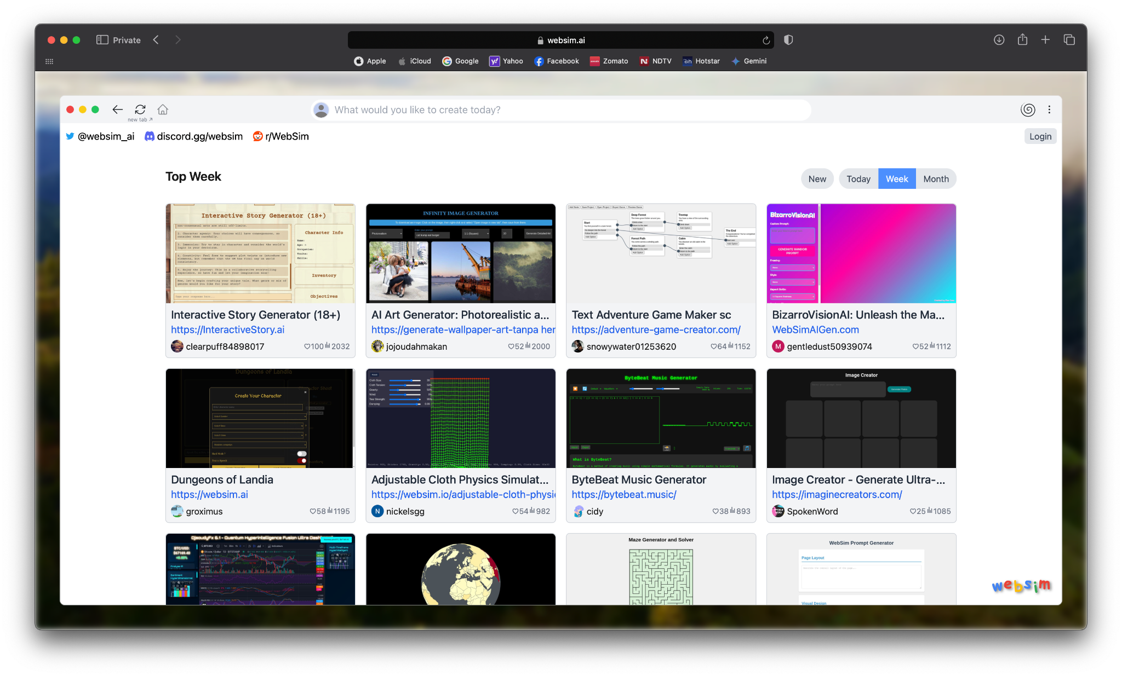
Step 3: Exploring Example Projects

Slide 7
Step 4: Creating a Portfolio Website
Flow all the steps from the step 4 as per the need to update the website, Here you can able to see the screenshots of the full page of the website as well as by click on this link you can able to find the full website

Slide 8
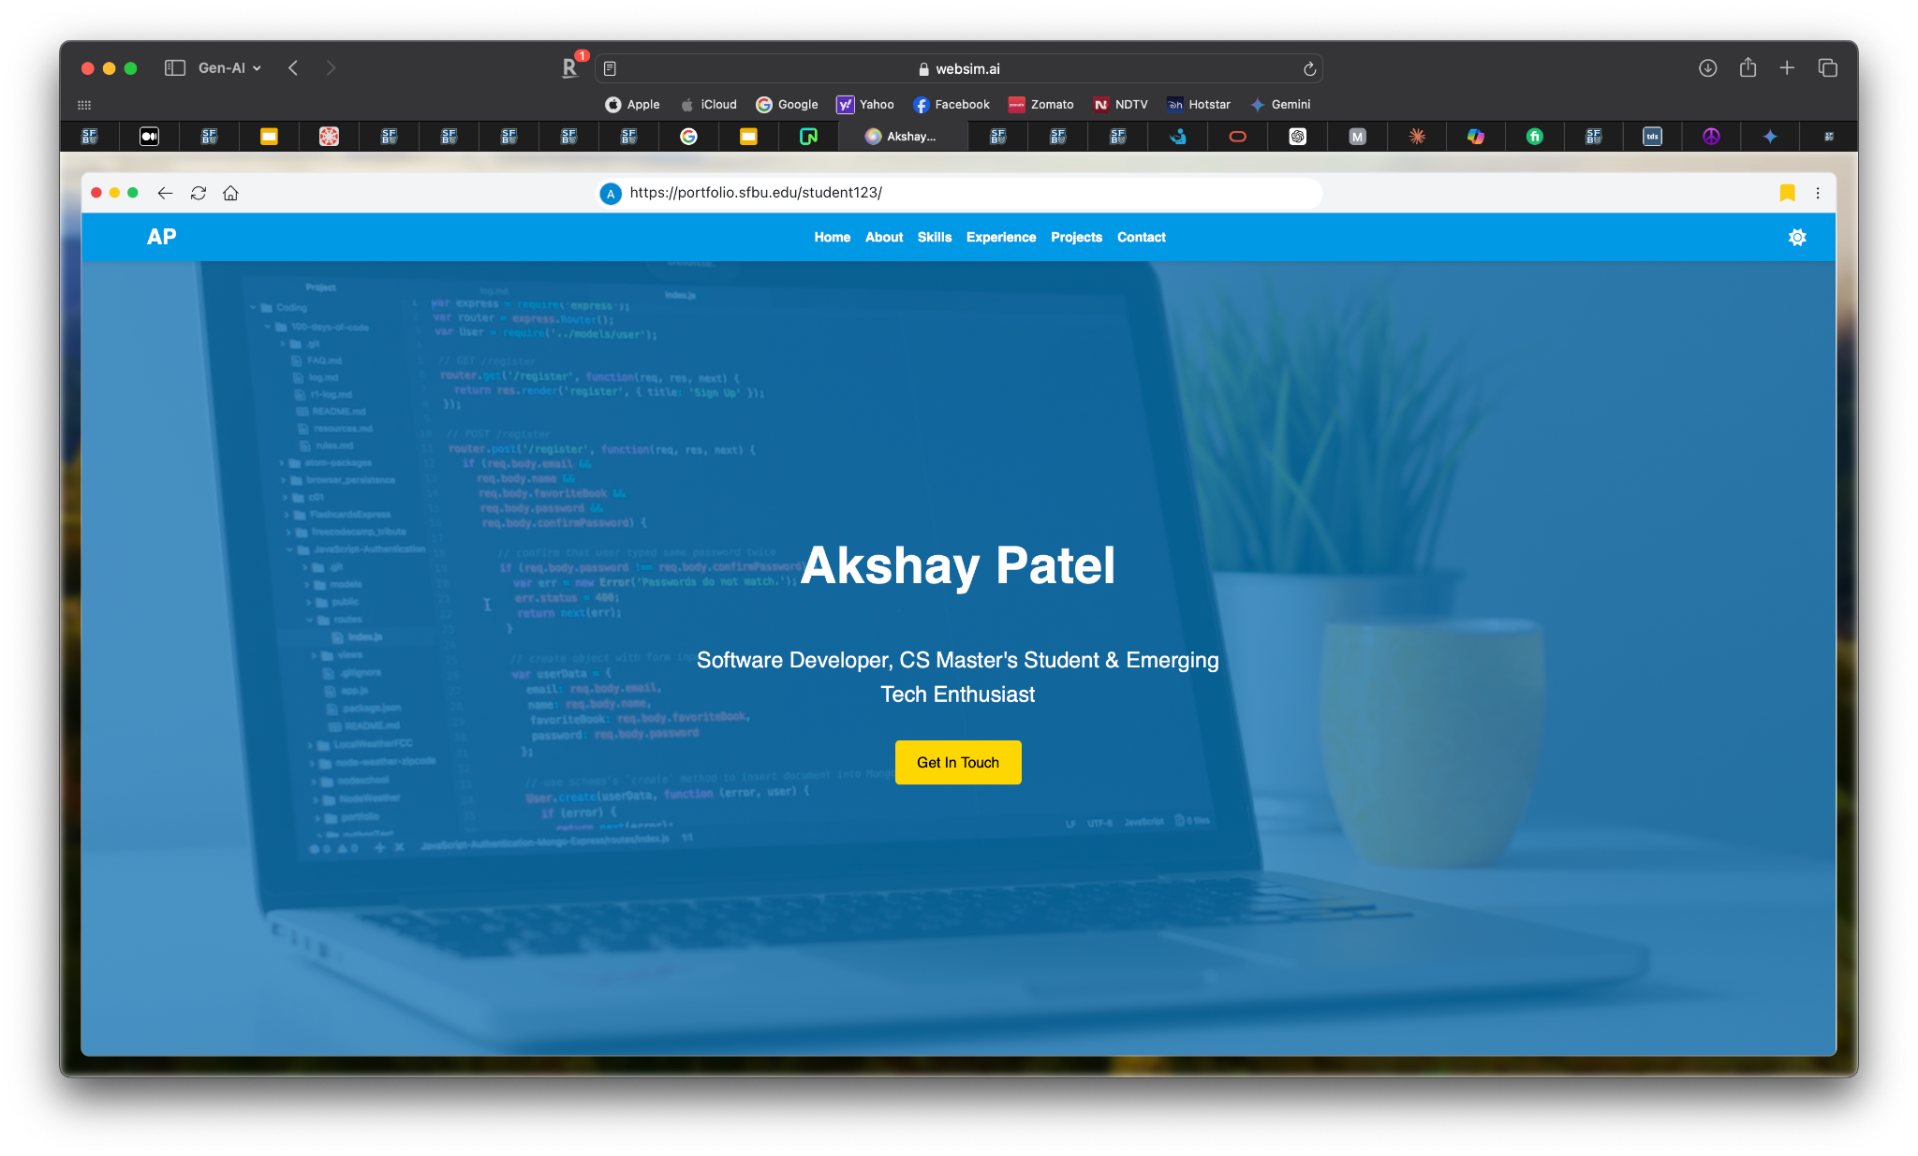

Slide 9
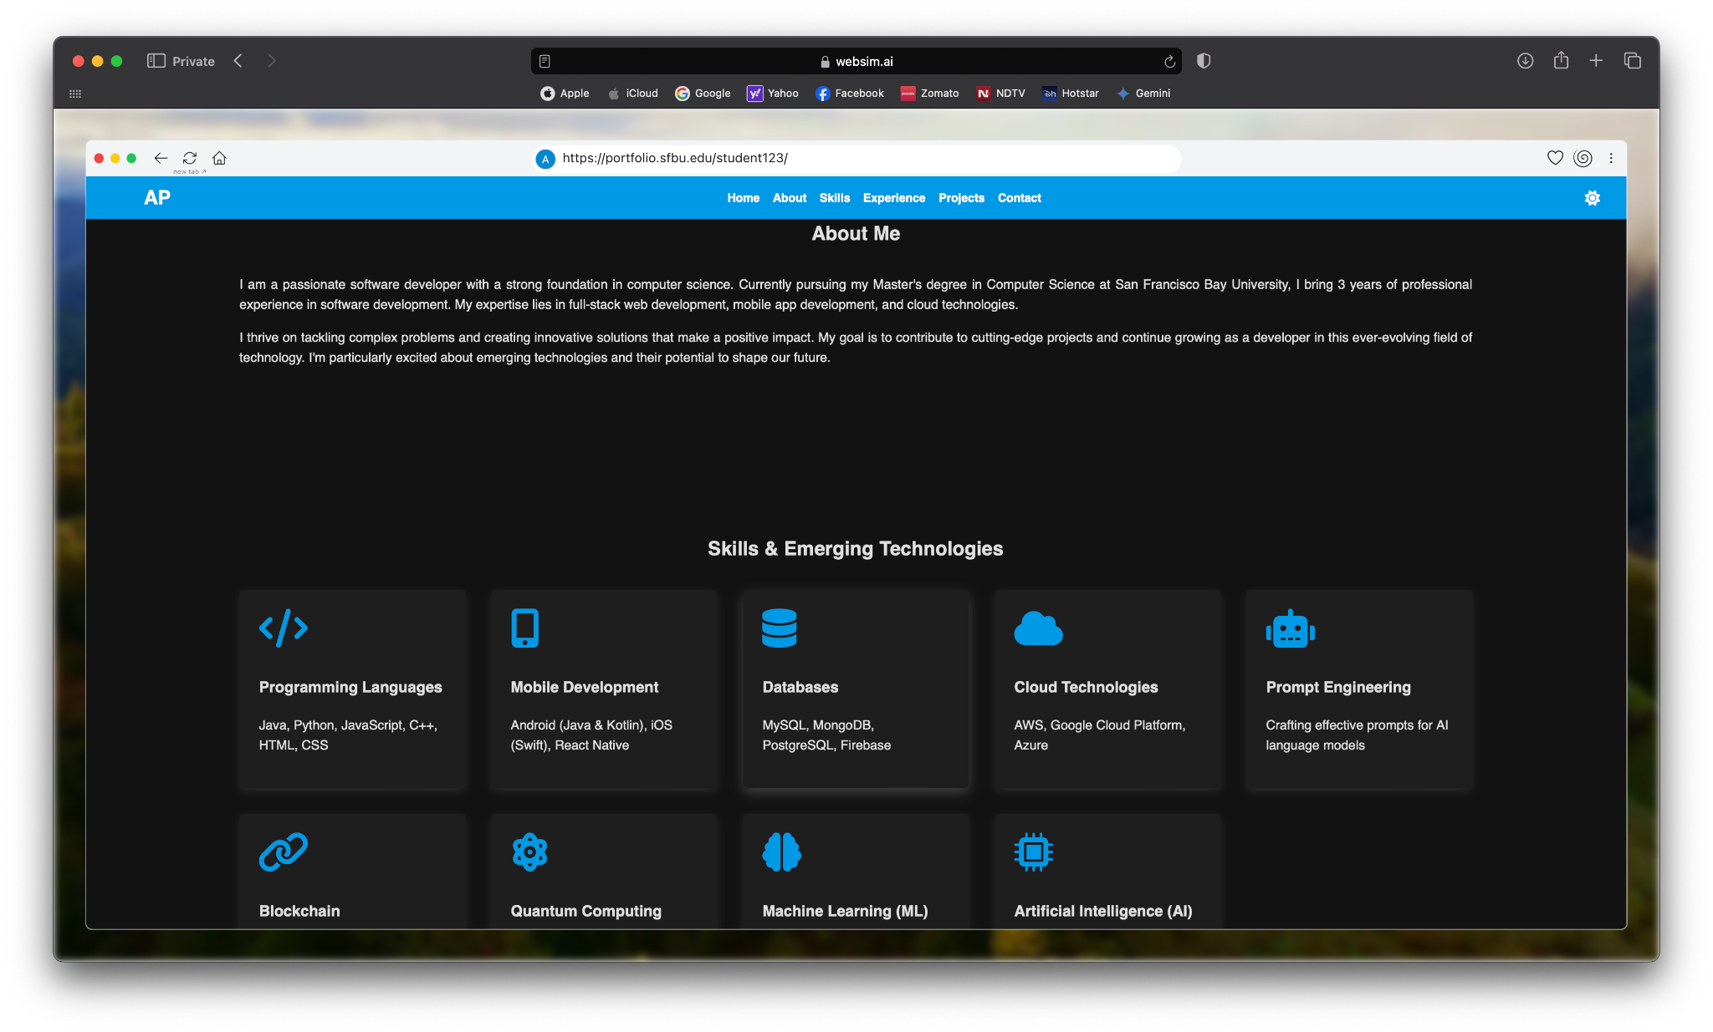

Slide 10
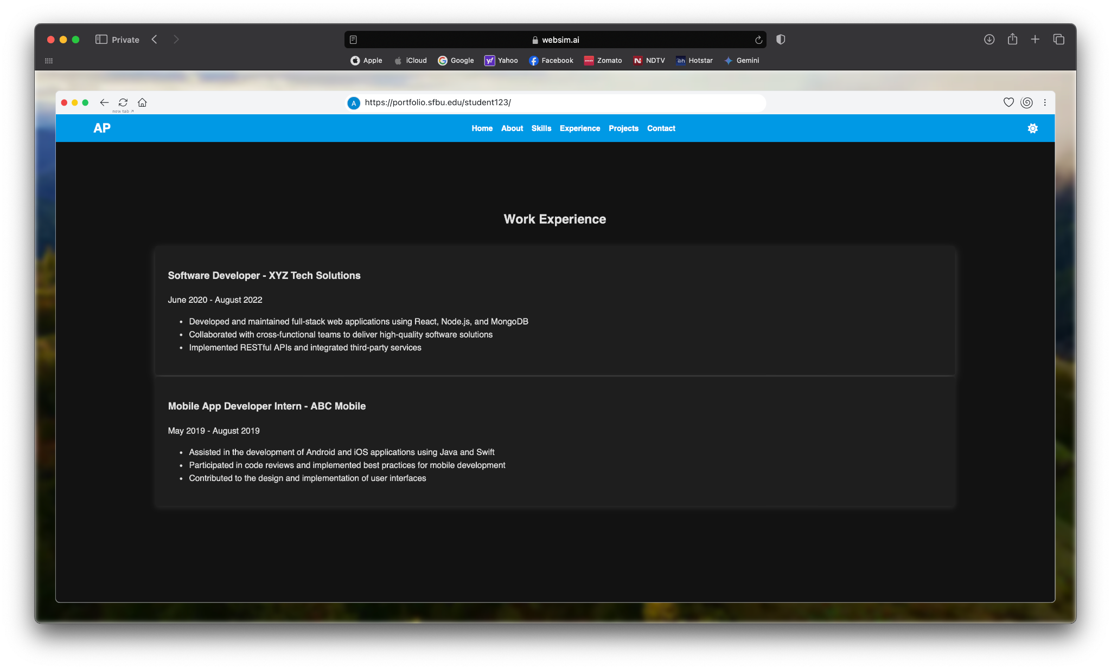

Slide 11
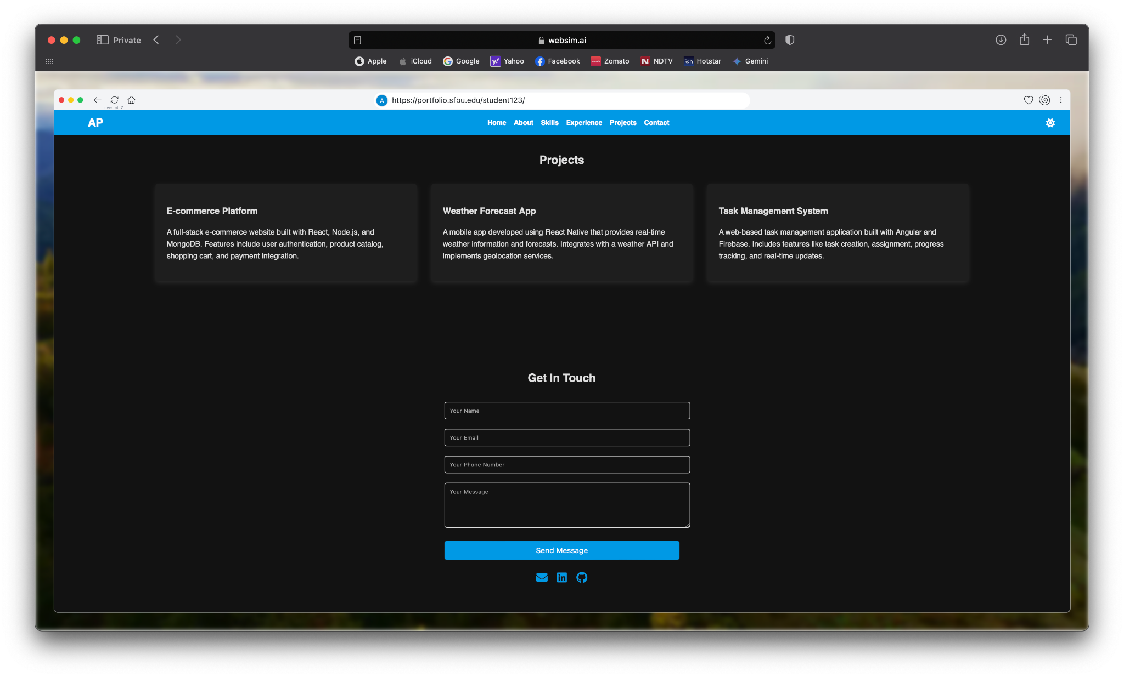

Slide 12
Github Project:
References:
https://github.com/AkshayPatel8140/Prompt-Engieering
https://websim.ai
https://medium.com/@thehowto/websim-ai-the-revolutionary-ai-tool-for-instant-website-and-app-prototyping-c73d975731da

Slide 13
Thank You

